Slide 1
WELCOME TO OUR COMPANY

Slide 2
CONTENTS
COMPANY PROFILE
COMPANY STRUCTURE
PRODUCT SEVICE
MARKET ANALYSIS
COOPERATIVE PARTNER

Slide 3
COMPANY PROFILE
PART 01

Slide 4
ABOUT US
Dragino Technology Co., Limited is founded by experienced engineers in 2010. We are specialists in product design, developing and manufacturing. We focus on the Internet of Things industry and keep evaluating new technology on improving user experience in IoT solution.

Slide 5
TARGET PLAN IN 2019
Develop more LoRaWAN sensors
Lower cost, more suitable LoRaWAN Gateway
Help customers provide more competitive solutions
A
B
C

Slide 6
COMPANY STRUCTURE
PART 02

Slide 7
General Manager
Vice General Manager
R&D
Department
Finance
Department
Purchasing Department
Sales
Department
Product
Department
There are 6 technicians

Slide 8
PRODUCT SEVICE
PART 03

Slide 9
LoRa IOT Kit
In Dragino LoRa IoT Kit, you can get:
Learning the Arduino code and some other mcu knowledge.
Learning how to use the commonly used sensors and the basic knowledge of Linux.
Learning the basic construction of IoT and how it works.
Learning how to build a LoRa network.
Learning how to use your sensor network to communicate with different IoT servers.

Slide 10
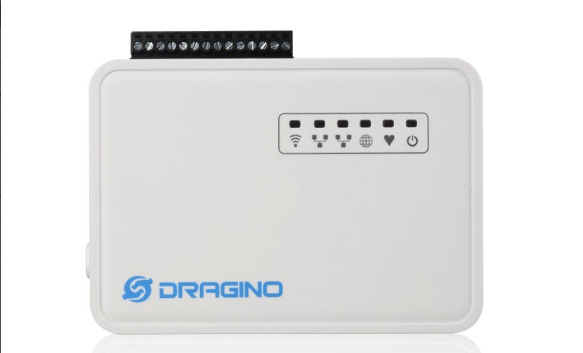
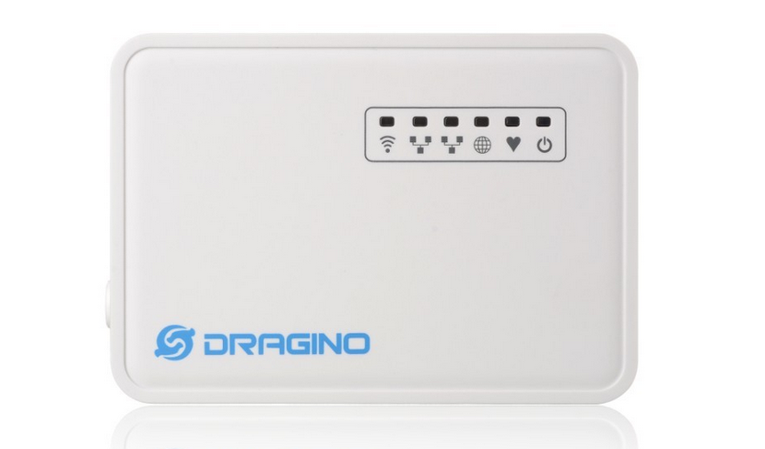
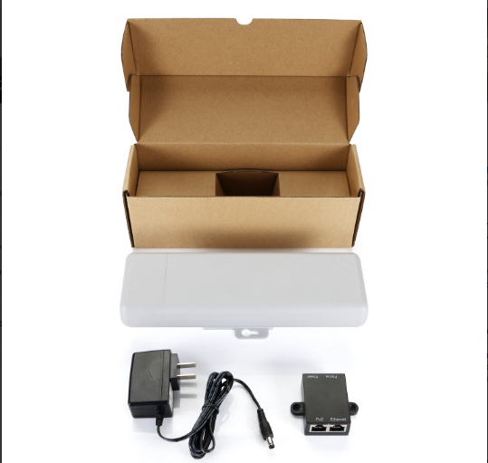
Linux IoT Appliance,
WiFi, Arduino Appliance
MS14N-S
Dragino Linux IoT Appliance With Sensor Terminal. Base on AR9331
MS14N-P
Dragino Linux IoT Appliance . Base on AR9331
PAN
WIFi Outdoor IoT Appliance

Slide 11
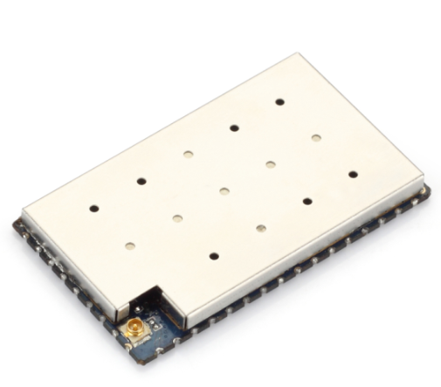
Linux WiFi, Mesh , IoT Module
HE
WiFi IoT Module, Arduino Yun Module

Slide 12
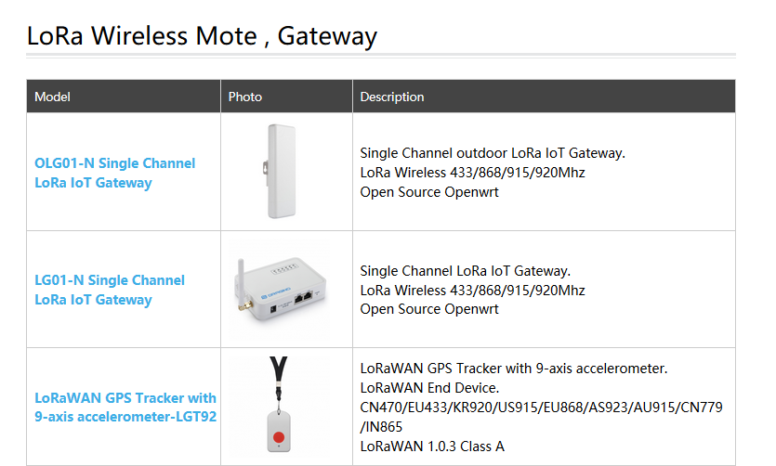

Slide 13
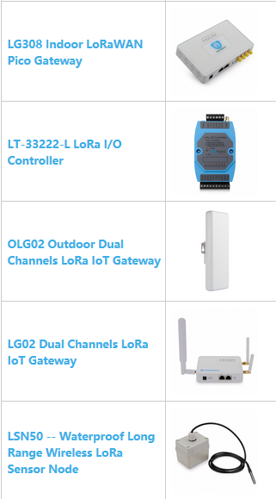
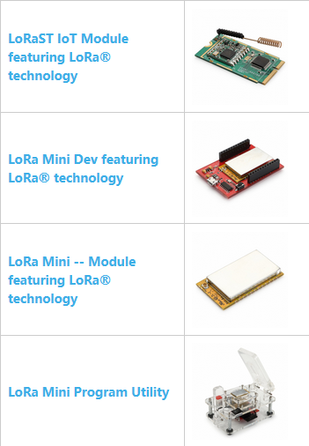
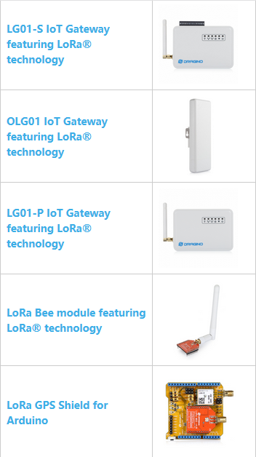
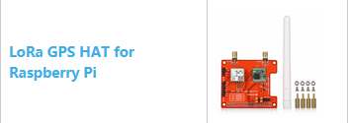

Slide 15
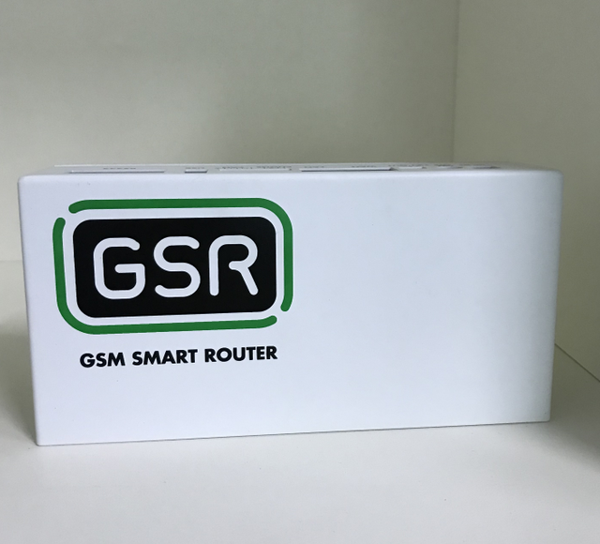
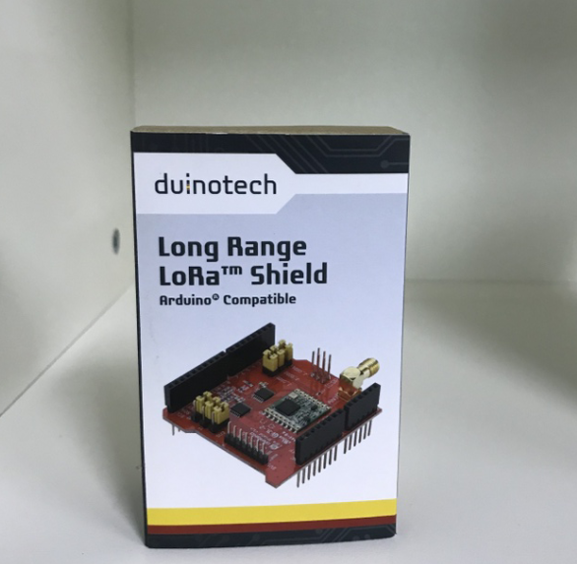
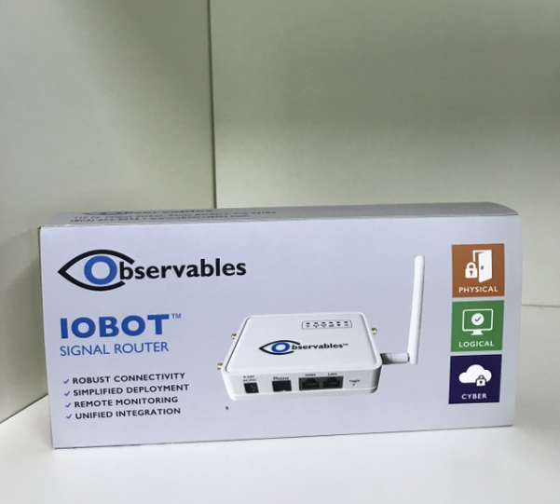
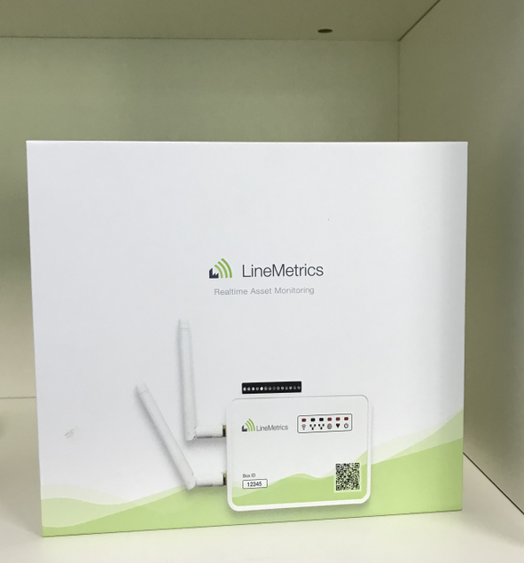
OEM/ODM
We provide OEM/ODM service base on requirement. below are some of them:
Customized logo on enclosure
Customized package design
Design assitant on modules
Manufacture / Assembly services for modules
We have a set of offshore products and development kits to help customers to test, design and produce innovation Internet of Things products in the shorter time, lower cost and lowest risk.

Slide 16
MARKET ANALYSIS
PART 04

Slide 17
LoRa Alliance Passes 100 LoRaWAN™ Network Operator Milestone with Coverage in 100 Countries

Slide 18
A
Own brand
Have a certain reputation in the market
B
Product independent research and development
Advantage
C
Focus on LoRa / IOT
D
We produce 100% full inspection，fixed patch factory

Slide 19
COOPERATIVE PARTNER
PART 05

Slide 20
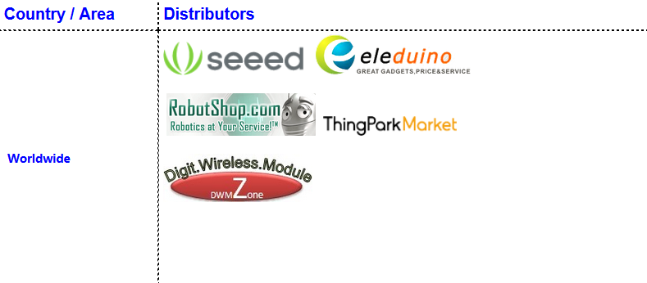

Slide 21
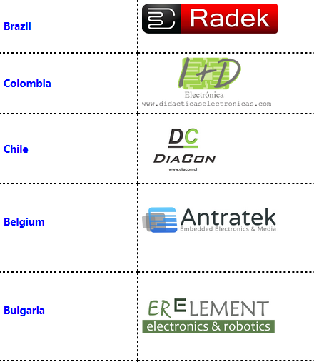
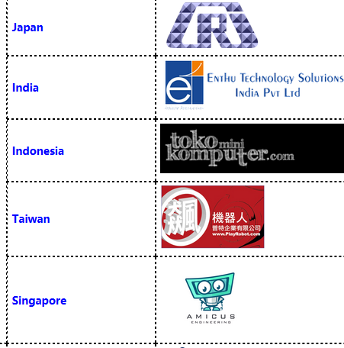

Slide 22
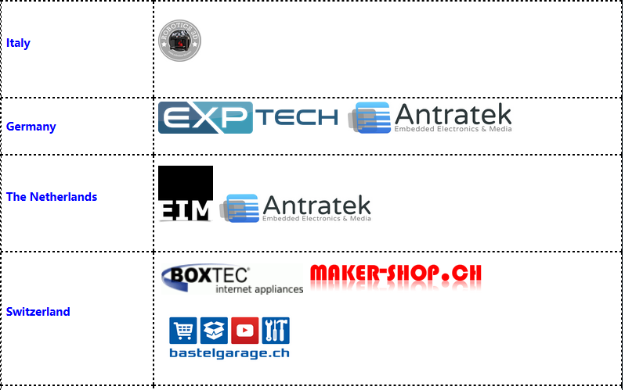

Slide 23
bucknell.eu
University of Oxford
bucknell.eu
Istanbul Universitesi
ucad.eu
duke.eu
wisc.edu

Slide 24
purdue.edu
mail.uc.edu
purdue.edu
swin.edu.au
utexas.edu
qu.edu.qa
University of Cassino

Slide 25
Ateneo de Manila University
Ateneo de Manila University
Universitat de Valencia
jhu.edu
Chulalongkorn University
University of Jyvaskyla
buffalo.edu

Slide 26
We aim to become a trusted and helpful partner for our customers and get the success in the IOT market together.

Slide 27
Thanks

